Slide 1
Unit 3
Toys

Slide 2
Where are they?

Slide 3
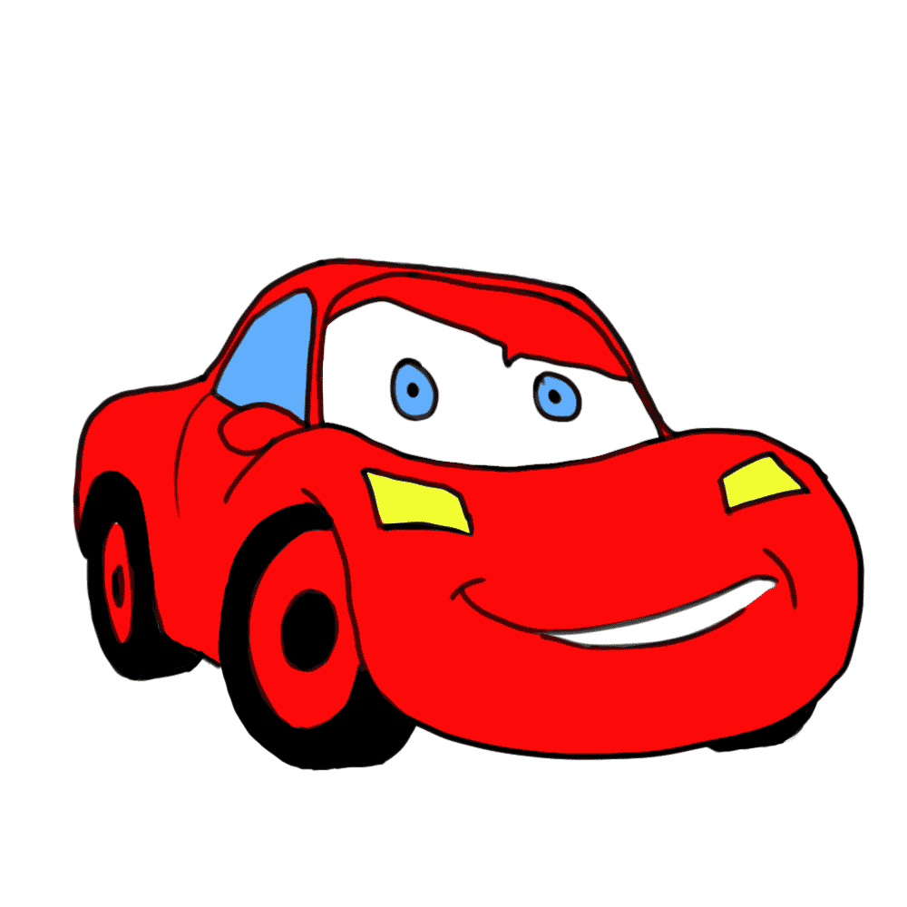
car

Slide 4
ball

Slide 5
doll

Slide 6
bear

Slide 7
plane

Slide 8
train

Slide 9
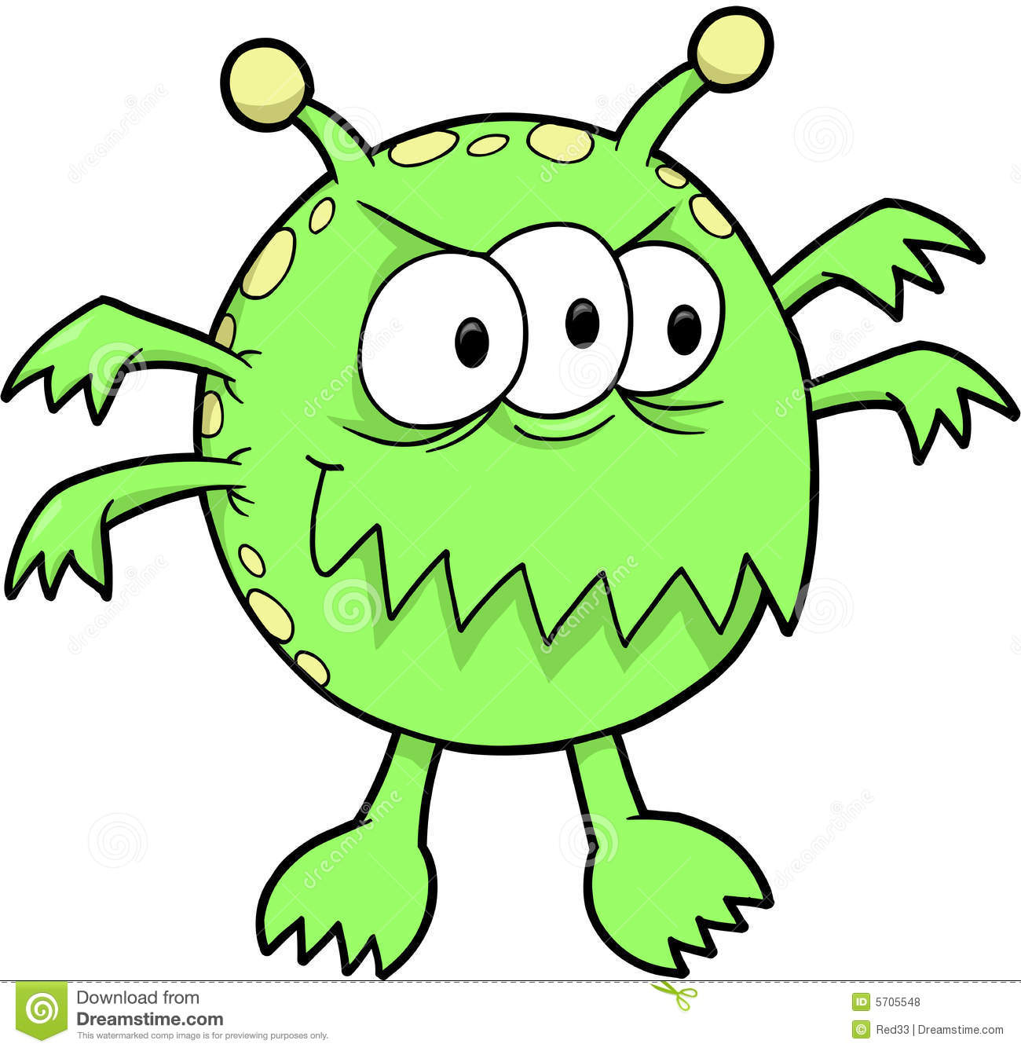
Here comes the monster!!!

Slide 10
c car

Slide 11
doll

Slide 13
ball

Slide 15
plane

Slide 16
bear

Slide 17
train

Slide 19
plane

Slide 21
ball

Slide 22
car

Slide 23
doll

Slide 24
train

Slide 25
plane

Slide 26
bear

Slide 27
Congratulations!
恭喜你挑战成功

Slide 28
train
car
ball
plane
bear
doll

Slide 29
Thanks for helping!
你还愿意接受一项新的挑战吗？

Slide 30
ball
doll
train
2
5
1
plane
6
bear
3
4
Notes:
让学生选择气球并点击，气球爆炸后会出现单词，要求学生读出该单词。

Slide 31
Thanks!
Make Presentation much more fun

