Slide 1
授课教师：拉珍

Slide 2
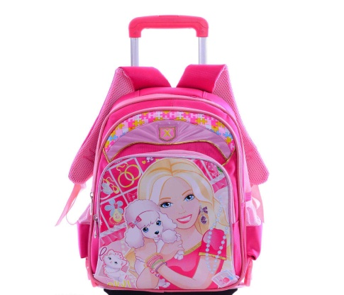
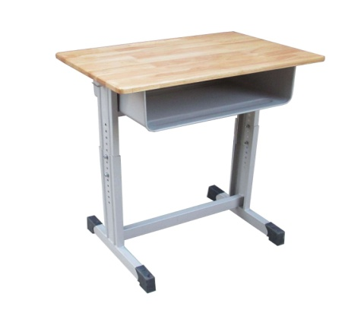
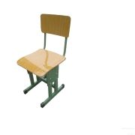
Review
schoolbag
desk
chair
blackboard

Slide 3
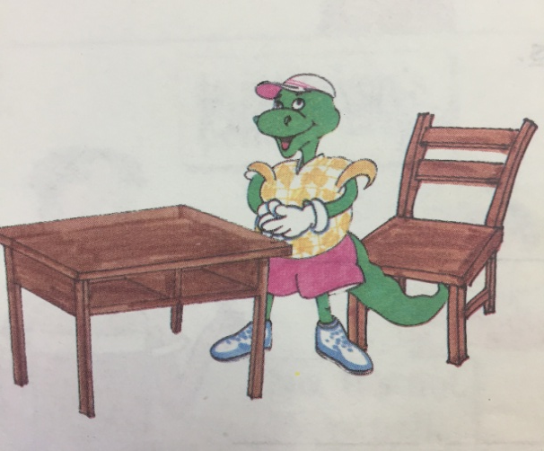
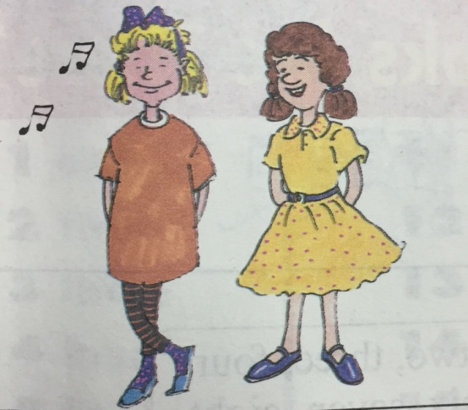
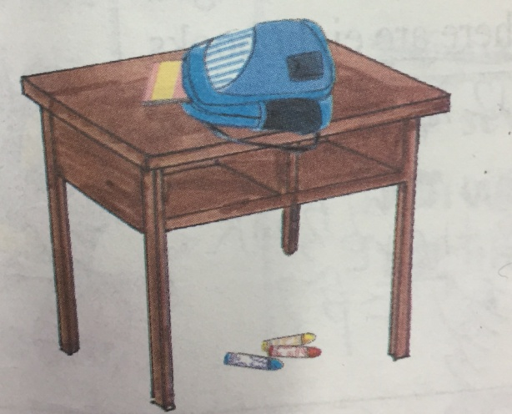
I can do it.
1.Danny is _______ the desk and the chair.
between
2.Jenny is _______ Kim.
beside
3.The schoolbag is ____ the desk.
The book is ____ the schoolbag.
The crayons are _____ the desk.
on
in
under

Slide 4
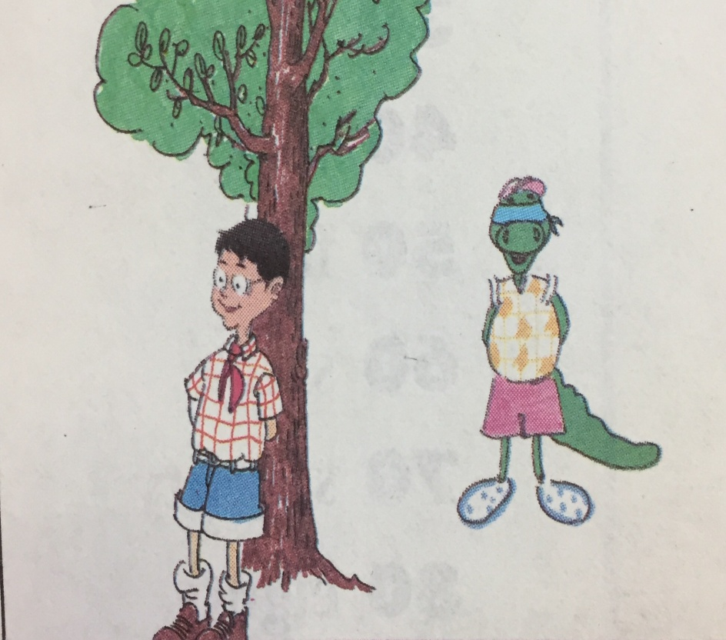
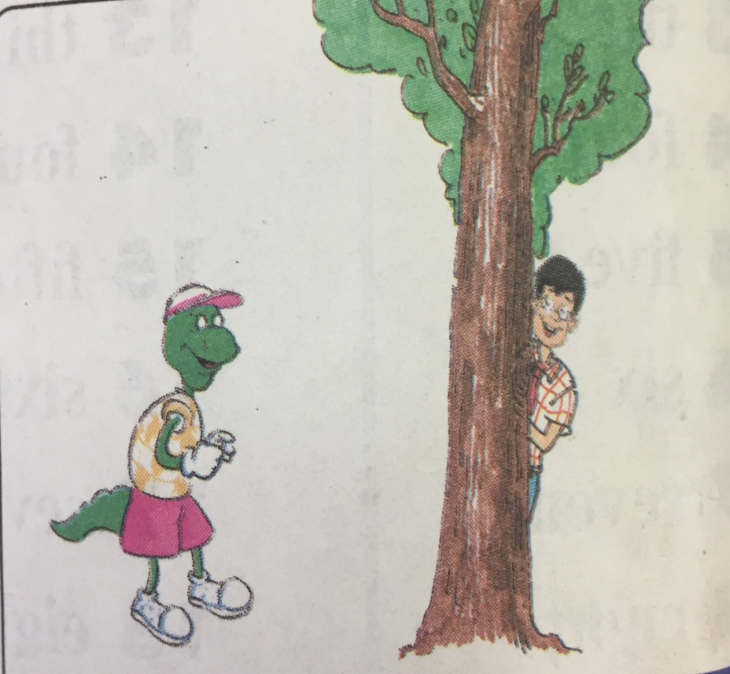
Lesson 5 Where is Danny?
in front of
behind

Slide 5
1. in front of , behind（介词）
in front of
在……前面
Li Ming is in front of the tree.
李明在树前面。
Danny is in front of the desk.
丹尼在课桌前面。
behind
在……后面
Li Ming is behind the tree.
李明在树后面。
Danny is behind the door.
丹尼在门后面。

Slide 6
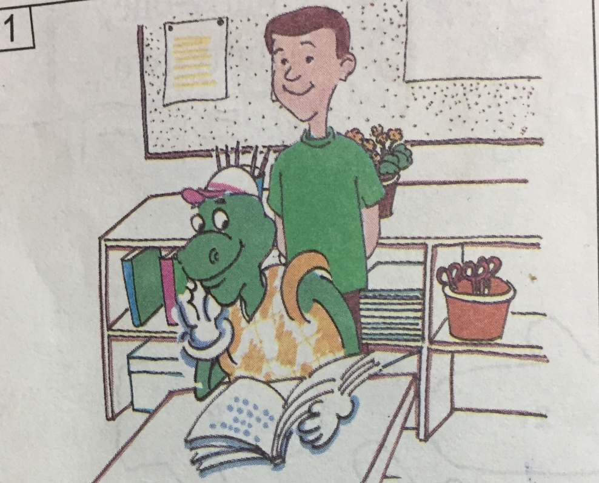
2. Where is Danny？
Where is Danny？
丹尼在哪里？
He’s in the classroom.
他在教室里。
He’s in front of Steven.
他在史蒂芬前面。
He’s reading a book.
他正在读书。
read a book 读书

Slide 7
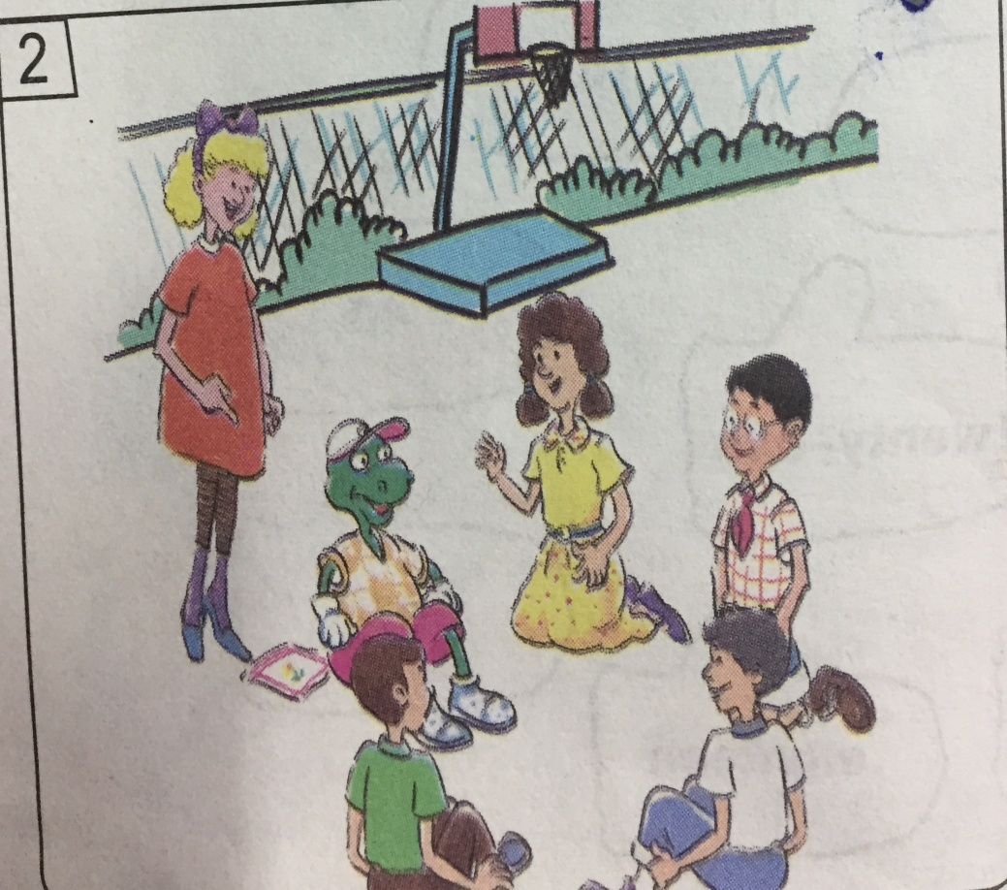
Where is Jenny?
詹妮在哪里？
She’s on the playground.
她在操场上。
She’s behind Danny.
她在丹尼后面。
They’re playing a game.
他们正在玩游戏。
play a game 玩游戏
现在进行时态：be动词+动词 ing 正在做……

Slide 8
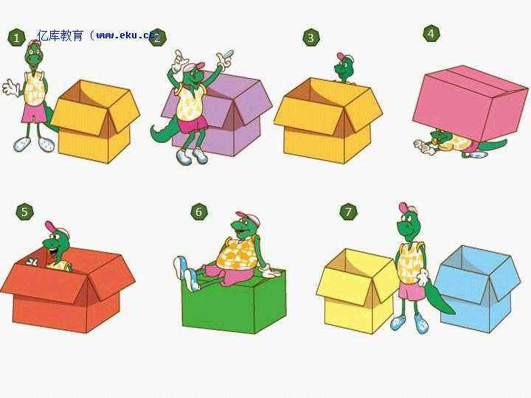
Let’s play a game.
beside
in front of
behind
under
in
on
between

Slide 9
I can say.
in front of
behind
李明在丹尼前面。
LiMing is in front of Danny.
我在扎西前面。
I am in front of ZhaXi.
扎西在卓玛后面。
ZhaXi is behind ZhuoMa.
老师在门后面。
Teacher is behind the door.

Slide 10
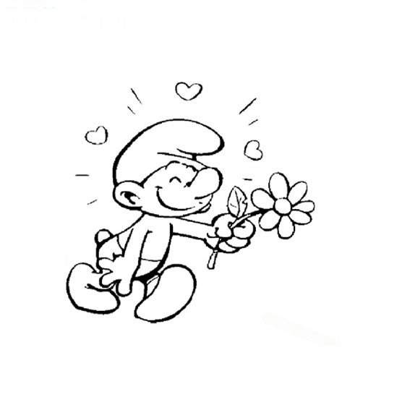
Homework.
1. 课本第11页的 第四部分 会读会写。
2. 完成互动英语。

Slide 11
Class is over , thanks for your come.
Good bye !

